Slide 1

COHORT EXECUTION WORKSPACE
ONROL
AI for Productivity & Monetisation
Moving beyond academic concepts to raw execution capability. Learn the toolkit, map your workflow equation, and build a unique service offering.

Slide 2
SECTION 01
ONROL
From Knowing to Doing
Closing the massive distance between understanding that artificial intelligence exists and building a structured workflow around your real-world tasks.

Slide 3






FROM KNOWING TO DOING
ONROL
Three Stages of the Day 2 Shift
1. Explore Tools
2. Maximize Output
3. Real Action
Discovering specialized engines built for particular tasks like document preparation, custom presentations, and workspace indexing.
Analyzing personal throughput and understanding exactly how AI automates repetitive tasks to clear room for high-judgement decisions.
Transitioning from general interest to shipping custom services and packaging capability into reliable monetization pathways.

Slide 4
SECTION 02
ONROL
The Productivity Landscape
Grouping technology by the actual category of execution, rather than fleeting product names or corporate rebrands.

Slide 5



THE PRODUCTIVITY LANDSCAPE
ONROL
The Three Buckets of Professional Work
Writing & Thinking
Layout & Visuals
Tracking & Organizing
Drafting messages, planning lesson units, analyzing research, and interacting deeply with raw textual information databases.
Converting thoughts, slides, outlines, and summaries into high-end presentation layers and professional brand images.
Storing institutional knowledge, auto-summarizing archives, and indexing custom files in structured workspaces.

Slide 6
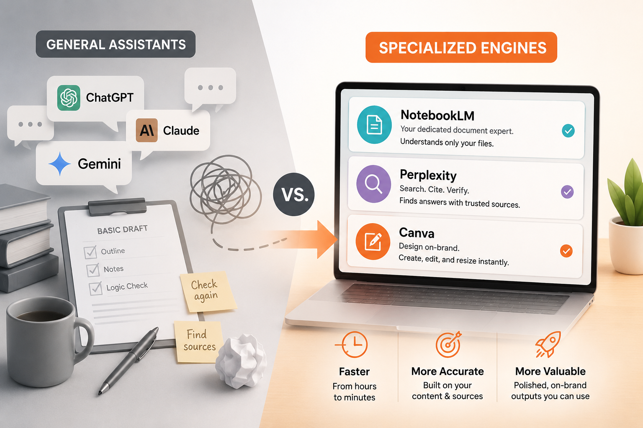
THE PRODUCTIVITY LANDSCAPE
ONROL
Tools for Writing & Information
General Assistants vs. Specialized Engines
General Assistants: ChatGPT, Claude, and Gemini act as versatile, multi-task partners for basic drafting and logic checks.
NotebookLM: Google’s dedicated document specialist. It reads only the specific files you upload, completely avoiding general model drift.
Perplexity: Replaces conversational explanation with a fully cited search engine that highlights authoritative source materials.

Slide 7
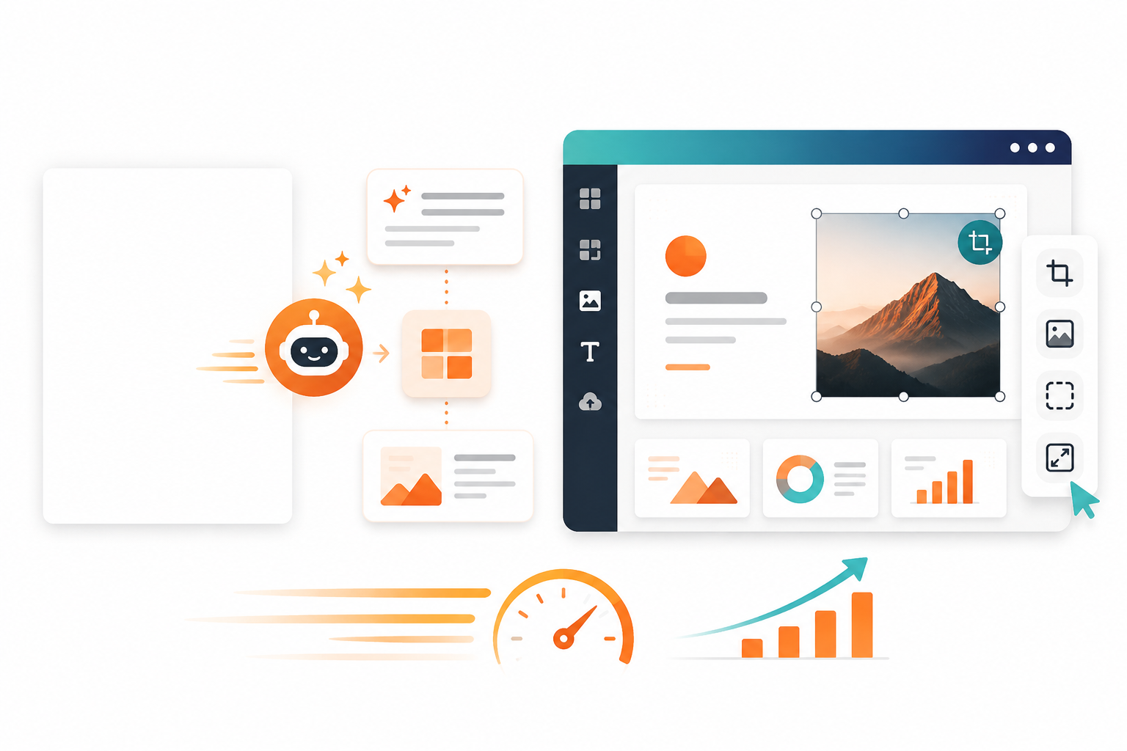
THE PRODUCTIVITY LANDSCAPE
ONROL
Tools for Visuals & Documents
Bypassing the Blank Page
Gamma & .AIi: Rapidly builds complete, formatted slideshow drafts from custom summaries, ensuring uniform branding.
Canva Integration: Integrates generation loops directly inside standard graphic spaces to edit layouts, clear backgrounds, and resize instantly.
Speed & Value: Turns slow, expensive manual design into quick internal workflows that take only minutes to ship.

Slide 8
SECTION 03
ONROL
Workflow Shifts
Breaking the age-old connection between human hours and output potential to optimize workspace value.

Slide 9
WORKFLOW SHIFTS
ONROL
The tool takes over the mechanical part of the work, and the person keeps, undiminished, the part that carries judgement and responsibility.
"
"
DR. VLN MURTHY — FOUNDER, ONROL SCHOOL

Slide 10
WORKFLOW SHIFTS
ONROL
The Same Work, Done Two Ways
Role & Context | Old Manual Way | New AI-Assisted Way | Actual Output Shift
Pune Teacher | Types & formats exams by hand after dinner | Feeds unit descriptions; adjusts AI questions | Saves hours; filters target metrics safely
Coimbatore Accountant | Manually updates reminder figures for 40+ clients | Feeds client detail matrices into a prompt loop | A full day of copying becomes a morning of checking
Hyderabad Job-Seeker | Rewrites individual covering notes from a blank page | Uses base resume to auto-tune cover summaries | Maintains high-quality pitches across 15 custom applications
Jaipur Photographer | Sifts manually through 2,000 photo layers to find 300 | Runs initial sorting & color adjustments with AI tools | Frees space to focus entirely on creative editing styles

Slide 11
SECTION 04
ONROL
Turning Capability into Value
How to leverage your background, combine it with automated speed, and structure AI-powered monetization models.

Slide 12



TURNING CAPABILITY INTO VALUE
ONROL
The Three Service Shapes to Build Income
1. Freelance Gigs
2. AI Consulting
3. Productised Services
Executing single, highly defined tasks for many clients, such as converting raw transcripts into publication-ready articles.
Selling advising frameworks instead of manual execution. Setting up toolchains and educating organizations on daily usage rules.
Packaging a repeatable result with standard pricing—such as delivering a monthly pack of customized visual posts for local SMBs.

Slide 13
TURNING CAPABILITY INTO VALUE
ONROL
Matching AI Offerings with Who You Are
Classroom Teachers (CBSE/State Board): Understand questions, learning gaps, and lesson design perfectly. Combine with AI to sell custom exam sets and summaries to test-prep coaching centers.
Homemakers & Local Business Owners: Understand neighborhood dynamics deeply. Use visual and content pipelines to coordinate social pages and WhatsApp offers for retail shops down the street.
Retired Officers & Administrators: Possess exceptional command over formal correspondence. Combine with LLM speeds to proofread and draft official summaries for growing companies.

Slide 14
SECTION 05
ONROL
Your After-Class Practice Tasks
Task 1: Compare Real Output & Speed Pick a regular text or design assignment. Do it once manually, then do it using a specialized AI tool. Record the exact execution times and compare the output qualities side-by-side.
Task 2: Map Your Working Week Audit your calendar. Identify and list every repetitive, mechanical task. Categorize each task and pick the exact tool bucket to tackle it.
Task 3: Draft Your Service Offering Formulate a monetization pitch. Connect your professional background with tools to build a custom gig, consulting plan, or packaged product offering.

